Slide 1
Private Wells and Water Systems: What's Critical What’s Missing: Jeffrey S. Broberg, LPG MnWOO brobergmnwoo@gmail.com c 507-273-4961
Minnesota Legislative Coordinating Commission: Water Subcommittee
.
October 17, 2019

Slide 2
MnWOO Mission: to provide education, technical advice, legal services, and advocacy to those Minnesotans who own private wells and to all those who rely on private wells for their drinking water and to preserve, protect, and restore Minnesota's water resources.
A 501(c)3 nonprofit

Slide 3
MnWOO is organizing in all six groundwater provinces
Minnesota has major regional differences in households, water sources and water quality

Slide 4
Groundwater is a shared resource, but Private Wells and Water systems are Different than Community Wells and Water Systems
75% of Minnesotans rely on groundwater from wells
75-80 % of Minnesotans rely on Community Water Systems
473,000 private wells serve 1.2 million Minnesota citizens (21%)
6,600 Minnesota communities serving over 3.5 million people use groundwater drawn from 1,074 shared and community wells

Slide 5
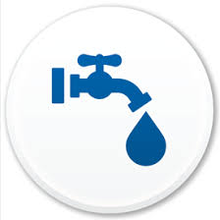
Groundwater is a shared resource but Private Wells are Different than Community Wells
US Safe Drinking Water Act (SDWA) protect community water supplies.
75% of Minnesotans rely on groundwater from wells
6,600 Minnesota communities serving over 3.5 million people use groundwater drawn from 1,074 shared and community wells
473,000 private wells serve 1.2 million Minnesota citizens (21%)
Public health protections cover community water supplies

Slide 6
Safe Drinking Water Act is 45 years old.
Enforceable standards for contaminates in drinking water
91 regulated contaminants
Requires water quality analysis, annual reports and public notifications of water system violations
Provides for the protection of underground sources of drinking water

Slide 7
Minnesota Well Code is 45 years old
The Well Management Program
Establishes standards for construction and sealing of wells and borings ("Minnesota Well Code").
Licenses contractors who construct, repair, and seal wells and borings.
Administers permits and notifications to construct and seal wells and borings.
Inspects the construction of new wells and borings, and the sealing of old wells and borings.
Follows up with property owners after property transfer to seal unused wells.
Maintains records on wells and borings.
Provides information, training, and technical assistance to contractors, other professionals, and the public.
Responds to well and well water quality problems caused by groundwater contamination events and natural disasters such as floods.

Slide 8
Mn WELL CODE
Well registration and disclosure required.
Well construction and well sealing standards
Casing and grouting required
Set-back distances
Water quality testing at the time of completion

Slide 9
Who relies on private wells?
¼ of all Minnesota Households
Urban, suburban, exurban and rural
An estimated 472,720 private wells
21% of Minnesotan’s
over 1.2 million people
Farms
Businesses

Slide 10
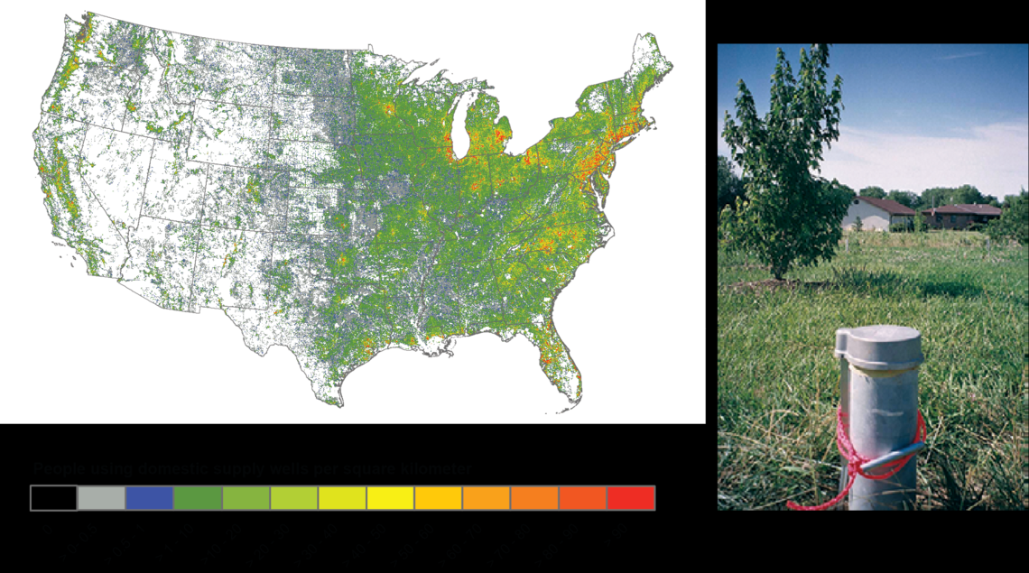
Where are the private domestic wells? USGS https://www.usgs.gov/mission-areas/water-resources/science/domestic-private-supply-wells?qt-science_center_objects=0#qt-science_center_objects

Slide 11
Water Quality in Domestic Wells USGS 2005
Nationwide study of 2100 wells
1 in 5 wells contained one or more contaminants above Health Limits
The most common contaminants were inorganic chemicals that had both natural and man-made sources
Metals, radionuclides and nitrates
Pesticides and solvents were detected in 60% of wells, but seldom above health limits.
Half of wells have one “nuisance” contaminant that impairs taste, odor and other aesthetic factors.
Bacteria and microbes were detected in 1/3 of wells that were analyzed.
Contaminants are usually in mixtures and co-occur with other chemicals

Slide 12
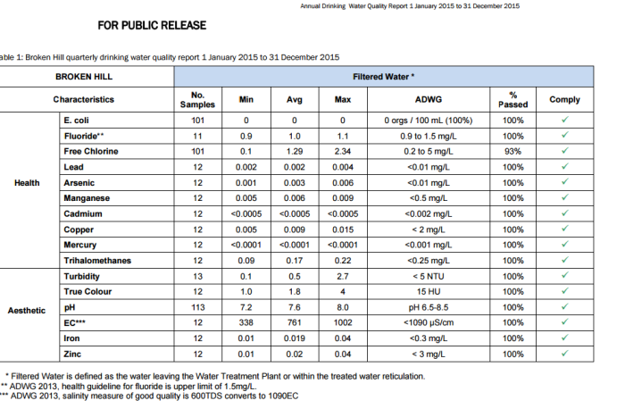
How do we talk about the risk of bad water? (2)
Nitrate risk to groundwater
Technical communication.

Slide 13
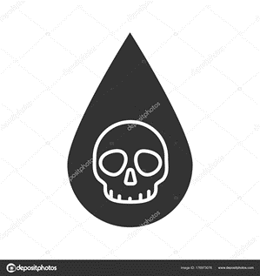
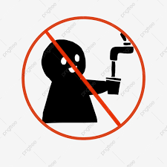
How do we talk about the risk of bad water? (1)
Mpls norovirus warning sign
Public communication.

Slide 14
Safe water at it's source does not guarantee safe water from the tap

Slide 15
Bad water at the source does not require us to drink bad water from the tap
Effective and affordable water treatment is available for almost any contaminant.

Slide 16
Minnesota needs to lead and create a path to the future for safe drinking water for every household.
In 2019 we still cannot ensure water availability, sustainable drinking water and sanitation for Minnesota

Slide 17
MN Drinking water management
What’s critical?
Informed well owners
Data
Water supply systems
Water Source
Pollution Sensitivity
Probability
Consequences
Effective risk assessment
Resources
What’s missing?
Effective Public Engagement
Understandable data
Practical advice
Realistic costs
Health and Safety benefits
Workable action plans for protection, enhancement and restoration of drinking water resources
Resources

Slide 18
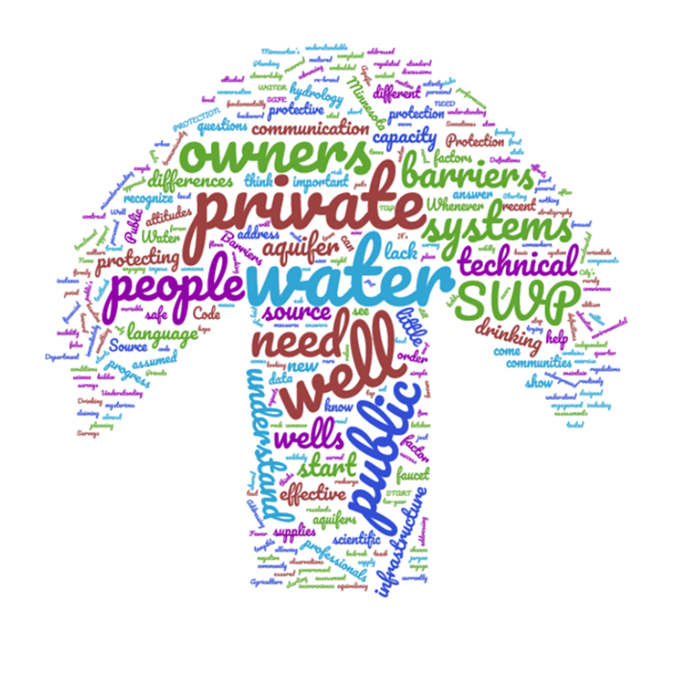
How we talk matters!
Simplified messages are necessary.

Slide 19
How we manage the human dimensions of water use matters.
We need accurate and practical information to address the barriers to safe water and need to attack and reject the biases and fallacies surrounding drinking water.
We need to communicate to well owners in different ways that are understandable at a level people understand, and with practical instructions that can make a difference.

Slide 20
What if Minnesota -
Developed a well assessment tool for evaluating private well and groundwater vulnerability for health departments, SWCD’s and extension programs?
Educated more than 1% or 7500 private well owners every year?
Informed and gave technical assistance to realtors, laboratory personnel, and sanitarians via online courses and webinars?
Trained over 500 environmental health professionals, state regulators, and drillers on well vulnerability assessment and best practices in well owner outreach in over 30 states?
Developed Spanish-language materials to reach a wider demographic of well owners?
Delivered online training on the risk of lead in homes served by private wells?

Slide 21
What if Minnesota:
Developed Water Safety Plans (WSP’s)
describe and analyze the drinking water supply chain;
• identify all the factors that can cause a risk of contamination;
• eliminate or mitigate these factors;
• prevent possible re-contamination.

Slide 22
Illinois has a plan.

Slide 23
The Private Well Class
The Science of Groundwater
Groundwater & Well Contamination
Well Construction & Related Issues
Your Water Well System
Operations, Maintenance & Best Practices
Emergency Situations & Problem Solving
Getting Help & Finding Local Answers
Groundwater Quality & Source Water Protection
Sampling & Interpreting Results
Water Treatment Solutions

Slide 24
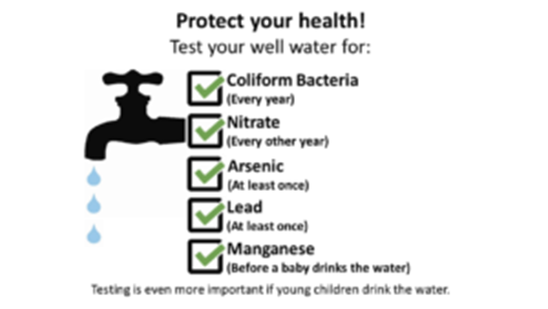
Water Quality testing at the kitchen sink:

Slide 25
Define our objectives and practice risk management.

Slide 26
What well owners want. What well owners need

Slide 27
What well owners get.

Slide 28
What well owners are grateful for.

Slide 29
MnWOO

